Slide 1
Philosophy of the New Age

Slide 2
Object and subject of philosophy of the New Age:
Оbject; the ways of the world’s perception by human;
Subject;
context between truth and delusion;
Problems of development of society and state.

Slide 3


Great Britain and France were leading states of the New Age

Slide 4
The main directions of the New Ages philosophy:
1) rationalism - type of philosophy, which recognize mind as a only one way of the world’s perception (created by Rene Descartes (1632-1704;)
2) empiricism – type of philosophy, which recognize experience as a only one way of the world’s perception (created by Francis Bacon (1561-1626);
3) sensualism- type of philosophy, which recognize feeling as a only one way of the world’s perception (created by John Locke (1632-1704).

Slide 5
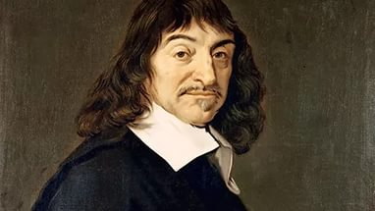
Rene Decartes (1632-1704) french mathematician фтв philosopher of rationalism

Slide 6
Basic ideas of Rene Decartes ’s philosophy
1) He believs that deduction is the best form of the world perception;
2) according to Decarts, deduction – is a form of logical thinking, which is characterized by the movement of thought from the general to particular.
3) кey concept of his philosophy was innate ideas - ideas that exist in the mind of a person from the first days of his life; (influence of Platon)
4) guideline of his philosophy was principle of the absolute doubt: according to it if we want to get the truth we must doubt it; if we cant-this is not truth but dogma. (influence of Socrat)

Slide 7
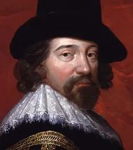
Francis Bacon(1561-1626) british philosopher of the empiricism

Slide 8
Basic ideas of Francis Bacon’s philosophy
1) he was on opinion that we must not only ways of learn the truth but also forms of misconceptions;
2) He believs that induction is the best form of the world perception;
3) according to Bacon, induction – is a form of logical thinking, which is characterized by the movement of thought from the particular to the general.
4) He was admirer of Aristotle’s logic and deducated to him his book “The New Organon”;
5) He was sure that absolute monarchy is the best form of government for Great Britain.

Slide 9

Ways of the world’s perception by Francis Bacon;
1. the way of bee–form of the wordl’s percection based on the human’s mind;
Bacon critisized rationalism of Decart and was sure that knowledge of mind must be verified by life-expirience

Slide 10

Ways of the world’s perception by Francis Bacon;
2. the way of spider–form of the wordl’s percection based on the life-expеrience;
Bacon believed that we must renew our life-experience if we want to avoid mistakes in the world’s condition

Slide 11

Ways of the world’s perception by Francis Bacon;
3. the way of spider–form of the wordl’s percection based on a harmonious combination of mind and life expеrience;
According to Bacon this is ideal form of the world’s perception.

Slide 12
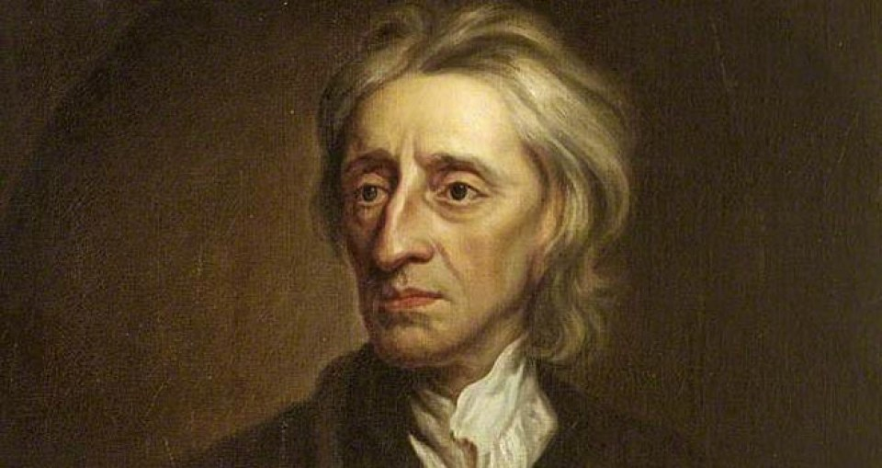
John Locke (1632-1704) british philosopher sensualism

Slide 13
Basic ideas of John Locke’s philosophy
1) his main book was titled “Two issues about the goverment”;
2) he critisize british absolute monarchy;
3) he create the principle of separation of powers; according to it power of state must be divided into three branches: executive, legislative and judicial; the most important is the legislative;
4) кey concept of his philosophy was- "clean board» -human mind at birth;

Slide 14
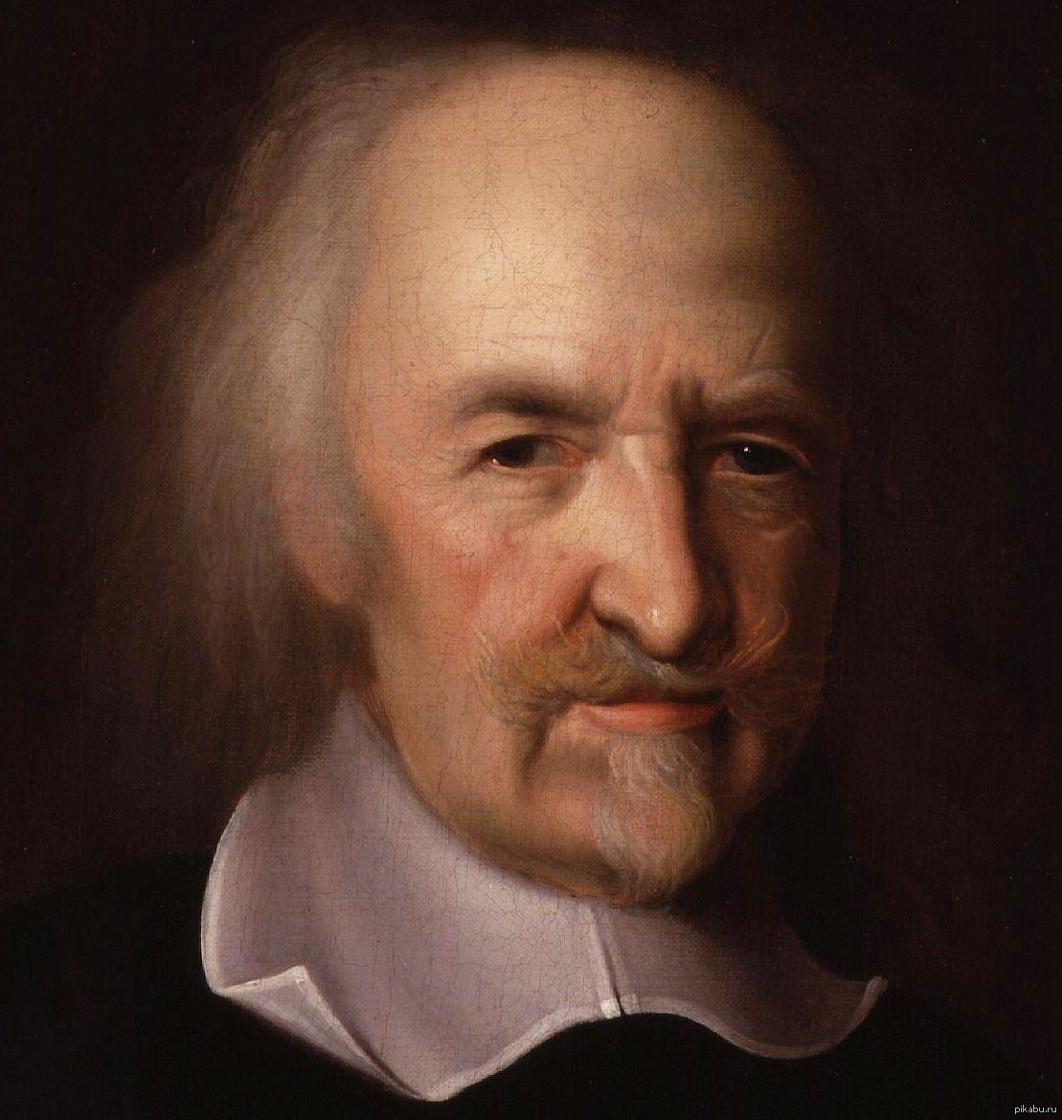
Thomas Gobbs (1632-1704) british philosopher of materialism

Slide 15
Basic ideas of Thomas Gobbs philosophy:
1) his main book was titled “The Lebiaphan”;
2) he was fond of absolute monarchy;
3) he create a theory of social contract; according to it creation of state is a result of contract between different social groups; conditions of social contract: state must define society and give it a prosperity; society must refuse from some part of it freedom and obey to government.
4) he believes that there is no way to disturb a social contract;
5) кey concept of his philosophy was natural condition – is a form of existence of society before creation of goverment and system of laws; Gobs identify the main aim of government in restraining of negative aspects of human nature

Slide 16
Summary
Name of philosopher | Type of his philosophy | Way of world perception | Basic concept
Rene Descartes | rationalism | mind | Innate ideas
Francis Bacon | empiricism | experience | Induction
John Locke Тhomas Gоbbs | sensualism materialism | feeling sense organs | Clear slate Natural condition

